Slide 1
Introduction to Machine Learning: A Hands-on Workshop
Zoë Wilkinson Saldaña, MSI
Arcus Education, DBHi

Slide 2

Hello!
Background: data science in academic libraries (Cornell University, University of Michigan)
Research interests: critical data science pedagogy; open source collaboration; reproducibility
Zoë Wilkinson Saldaña, MSI
Data Instructional Specialist
Arcus Education

Slide 3
Machine Learning with METACHOP
Introduction to Machine Learning *
Machine Learning II / Topics in ML

Slide 4
Machine Learning with METACHOP
Our schedule for today:
Presentation + Colab Setup: 12:10pm – 1pm
Hands-on Notebooks: 1pm– 2:30pm
Wrap-up discussion: 2:30pm-2:50pm
Self-guided work, learner questions: Here till 3:30pm

Slide 5
TAKEAWAYS
Connect research questions with machine learning methods
Write, run, and iterate on a classification pipeline in Python that generates meaningful metrics of “success”
Find peers, colleagues, collaborators, co-learners

Slide 6

Turn to your neighbors
What project or problem are you currently working on that you hope to apply machine learning to?
What is the most important thing you hope to learn today?
Icons made by Freepik from www.flaticon.com

Slide 7
Why approach a research question with machine learning?

Slide 8
What is machine learning?

Slide 9
What is machine learning?
Generalizing from observed data to new, previously unobserved data (e.g. future observations, new datasets in problem domain)
Focused on prediction tasks such as assigning a label or value
Data-driven models that “learn” when exposed to training data

Slide 10
Relationship to Statistics
Statistics
model first
inference emphasis
Machine learning
data first
prediction emphasis

Slide 11
Types of machine learning

Slide 12
Types of Machine Learning
Supervised
Unsupervised
Reinforcement

Slide 13
Supervised learning
Given input variables or features, predict the correct output or target
Can predict two types of target:
label (benign /malignant) or
quantity (9 hours)
Relies on labeled training data
(x_{i},yi)∝p(x,y) i.i.d.
x_{i}∈ℝ^{p}
y_{i}∈ℝ
f(x_{i})≈y_{i}

Slide 14
Supervised learning
(MI = myocardial infarction)
Given input variables or features, predict the correct output or target
Can predict two types of target:
label (benign /malignant) or
quantity (9 hours)
Relies on labeled training data
Deo, R. C. (2015). Machine learning in medicine. Circulation, 132(20), 1920-1930.

Slide 15
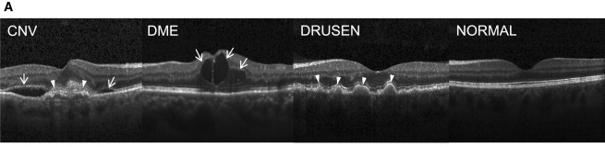
Examples of Supervised Learning
Detecting spam based on e-mail characteristics
Diagnosing retinal disease based on OCT images
Predicting sepsis events based on NICU vitals
Kermany, D. S., Goldbaum, M., Cai, W., Valentim, C. C., Liang, H., Baxter, S. L., ... & Dong, J. (2018). Identifying medical diagnoses and treatable diseases by image-based deep learning. Cell, 172(5), 1122-1131.

Slide 16
Generalization
Not only f(xi)≈yi
Also for new data: f(x)≈y
Generalize from:
Training -> test data
Trained model -> new observations in field (e.g. classification at bedside)
Trained model -> new observations in totally different domain
…

Slide 17
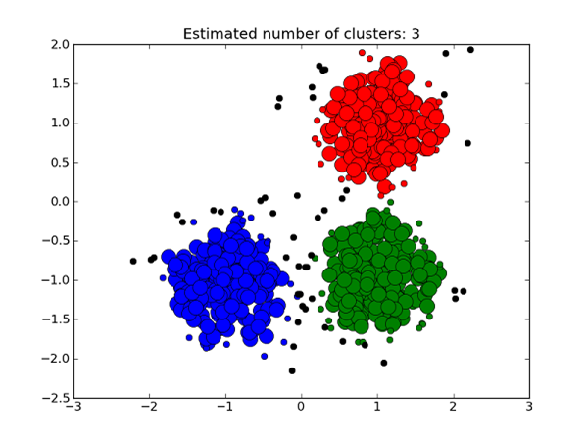
Unsupervised Learning
Given input features, assign to a cluster or class
System must detect groups ”on its own” – training data doesn’t have labels
x_{i}∝p(x) i.i.d.
Learn about p.
https://medium.com/deep-math-machine-learning-ai/different-types-of-machine-learning-and-their-types-34760b9128a2

Slide 18
Unsupervised Learning
Clustering: detect k groups of observations and assign new observations a group
often exploratory
Dimensionality reduction: reduce the number of variables in data while losing as little information as possible
“clustering for variables”
Sidey-Gibbons, J. A., & Sidey-Gibbons, C. J. (2019). Machine learning in medicine: a practical introduction. BMC medical research methodology, 19(1), 64.

Slide 19
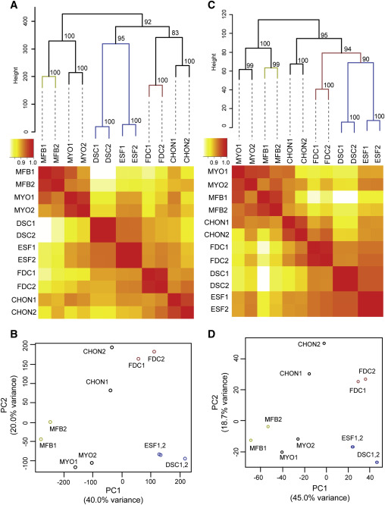
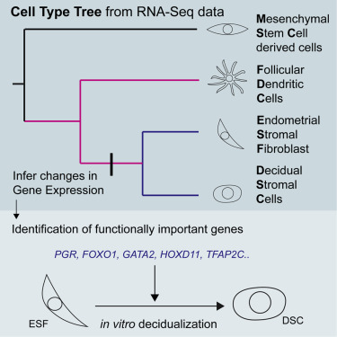
Unsupervised Learning
Task: Infer historical relationships among cell types, and use to learn more about gene expression
Kin, K., Nnamani, M. C., Lynch, V. J., Michaelides, E., & Wagner, G. P. (2015). Cell-type phylogenetics and the origin of endometrial stromal cells. Cell reports, 10(8), 1398-1409.

Slide 20
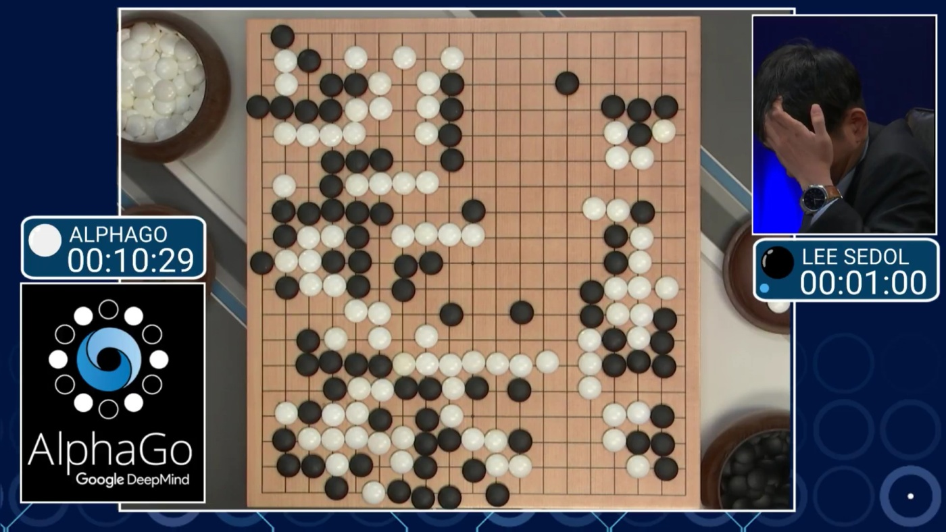
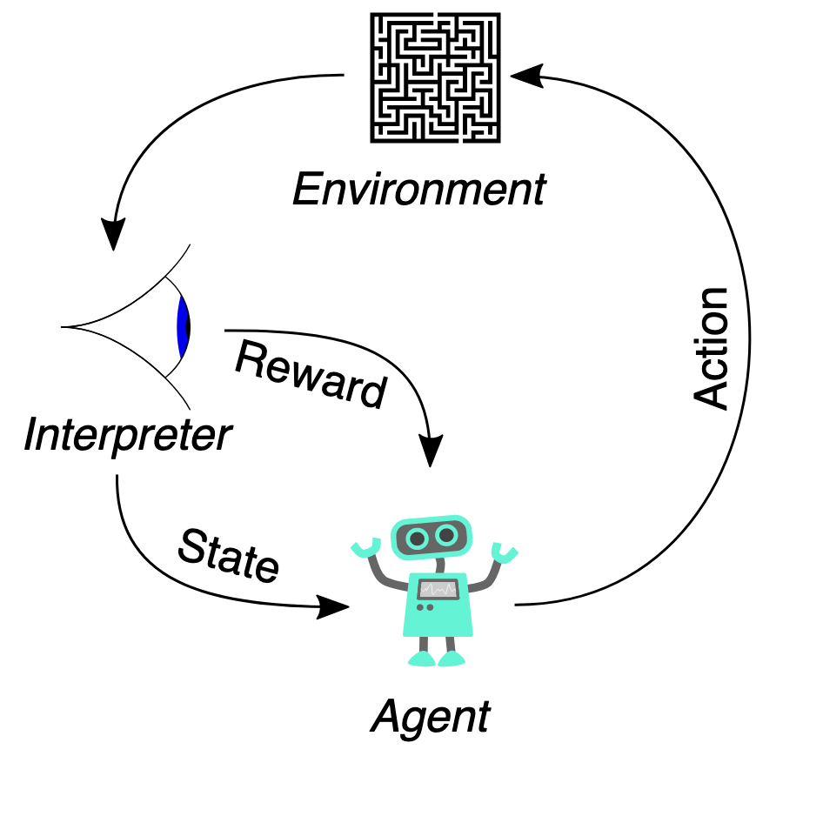
Reinforcement Learning

Slide 21
Features and targets
(MI = myocardial infarction)
Features are all the variables you will use to make a prediction. We could have 3, 4, 100, 1,000, or 6 million features..
Targets are the outcome variables we are trying to predict. For a given ML task, this is almost always a single variable (categorical or numeric).
Deo, R. C. (2015). Machine learning in medicine. Circulation, 132(20), 1920-1930.

Slide 22
Turn to your neighbors
With your neighbor, come up with an example of a research question for:
Classification (labeled training data, category output)
Regression (labeled training data, numeric output)
Clustering (unlabeled training data, cluster class output)
Icons made by Freepik from www.flaticon.com

Slide 23
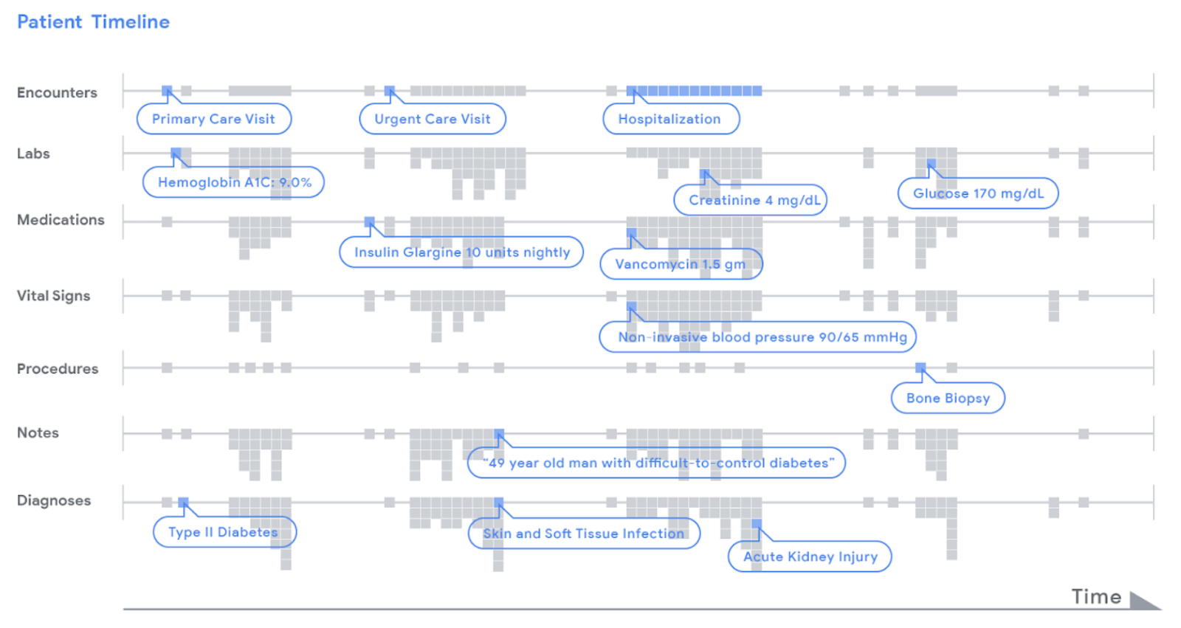
Features and targets
https://ai.googleblog.com/2018/05/deep-learning-for-electronic-health.html

Slide 24


Model selection
Deo, R. C. (2015). Machine learning in medicine. Circulation, 132(20), 1920-1930.

Slide 25
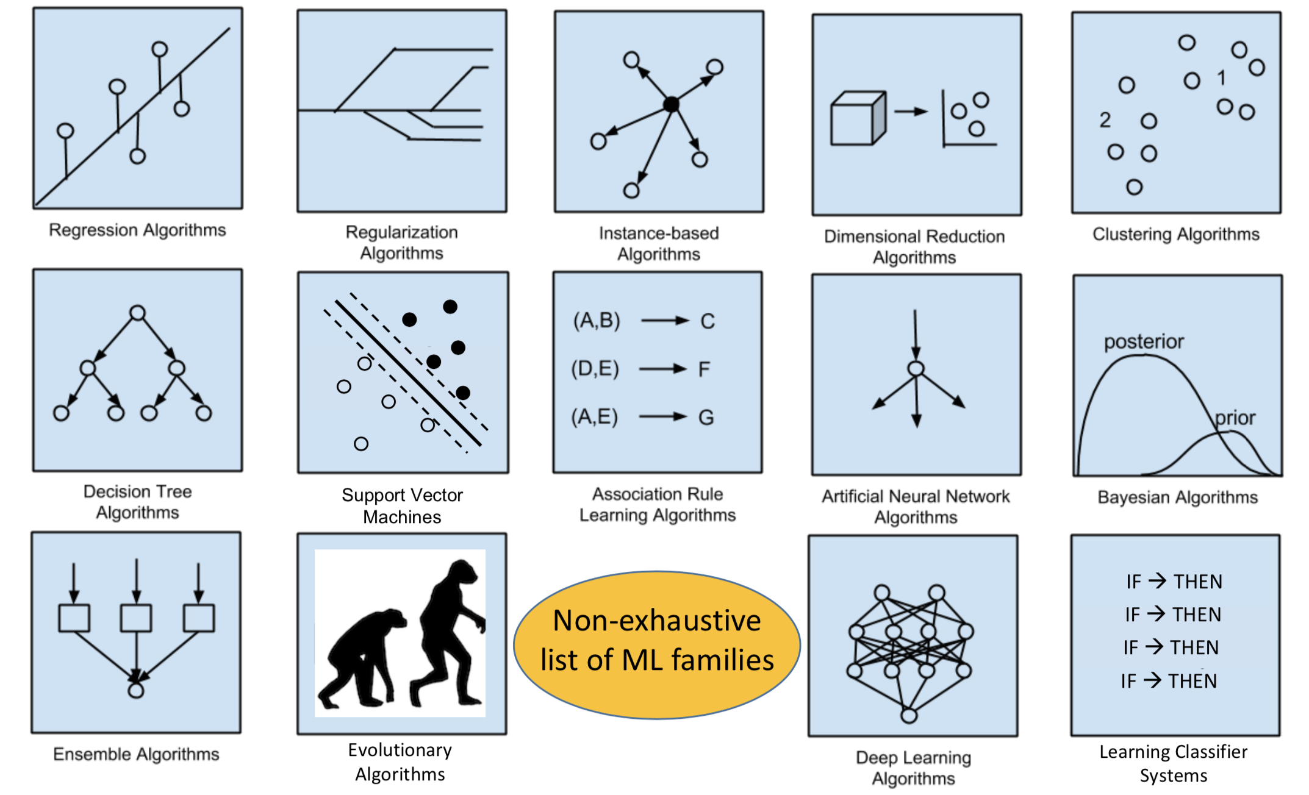
No free lunch theorem

Slide 26
Start with your task + data
Am I trying to reduce complexity of my data’s features?
2) Is my training data labeled? (do I know the “right answer”?)
3) If so, am I predicting a categorical or continuous/numeric target?

Slide 27
Start with your task + data
Am I trying to reduce complexity of my data’s features?
Dimensionality reduction or not?
2) Is my training data labeled? (do I know the “right answer”?)
Supervised or unsupervised?
3) If so, am I predicting a categorical or continuous/numeric target?
Classification or regression?

Slide 28
Model selection (& “no free lunch” theorem)
https://blogs.sas.com/content/subconsciousmusings/2017/04/12/machine-learning-algorithm-use/

Slide 29
Model selection (& “no free lunch” theorem)
YES training data is labeled

Slide 30
Supervised classification models for today
k-nearest neighbor (instanced-based or lazy learning)
Kernal SVM (support vector machine)
Random Forest (ensemble of decision trees)

Slide 31
Parameters vs hyperparameters
Parameters: Weights, rules, and other learned elements that algorithm uses to assign output class.
Hyperparameters: Settings that determine how the learning algorithm functions. Can be modified or “tuned” for optimal performance.

Slide 32
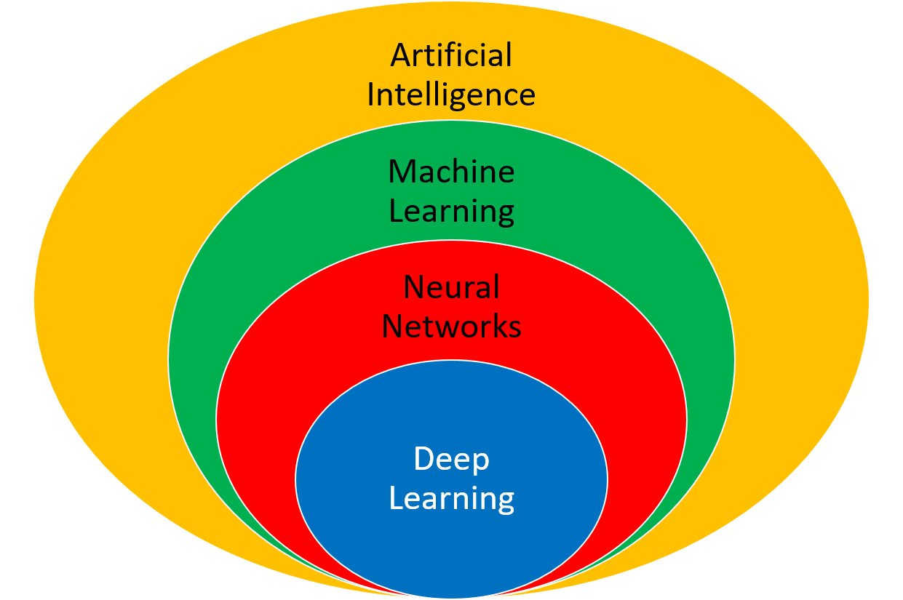
Other kinds of learning
Semi-supervised
Active Learning
Forecasting
…
https://apmonitor.com/do/index.php/Main/DeepLearning

Slide 33
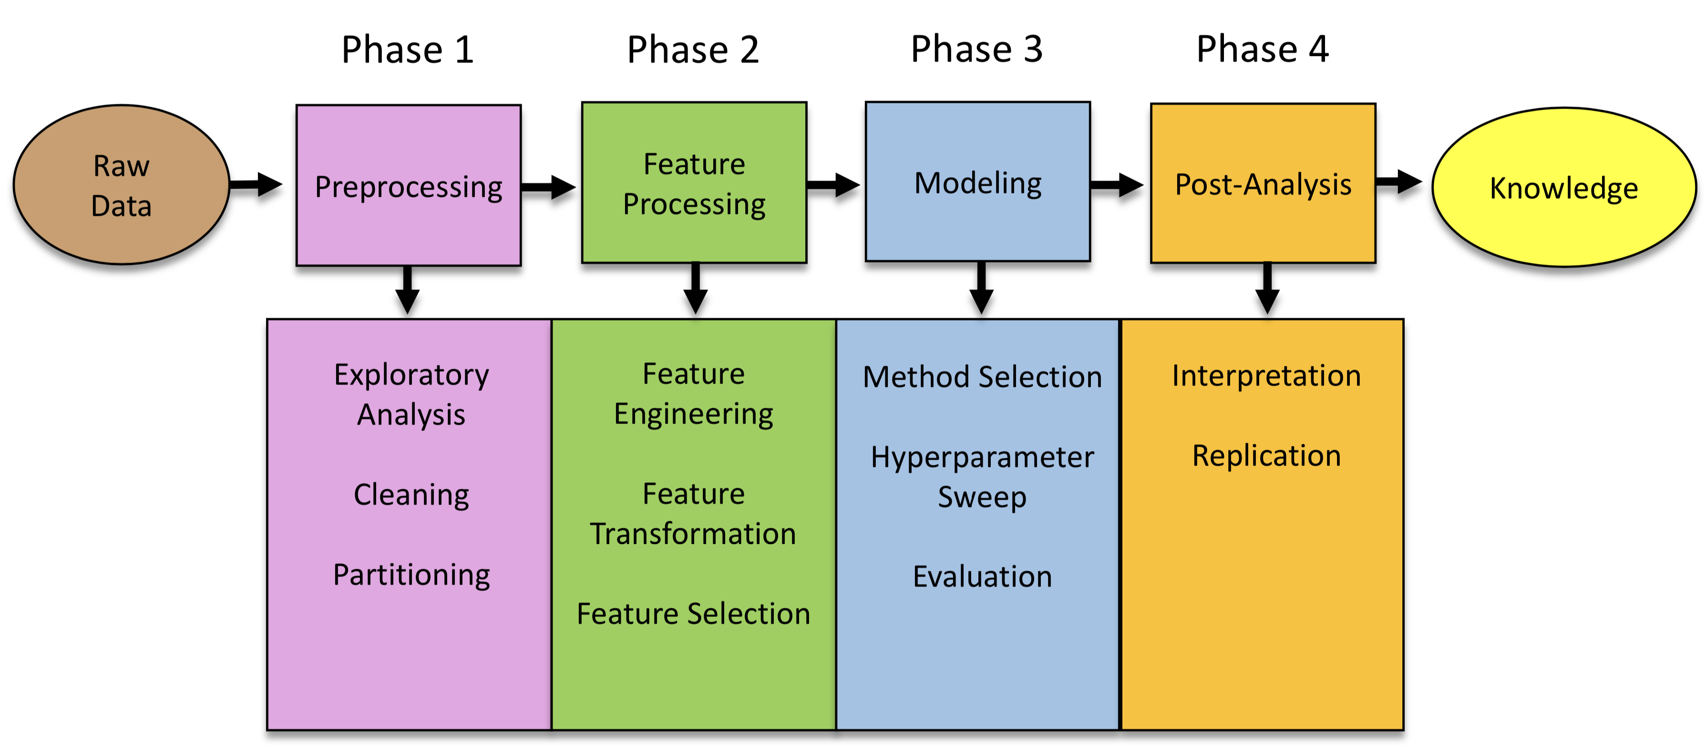
The full spectrum

Slide 34
For today

Slide 35

For today

Slide 36
https://www.sciencedirect.com/science/article/pii/S0092867418301545?via%3Dihub
https://www.youtube.com/watch?v=EuBBz3bI-aA

Slide 37
Communicating Results
Explainable results
Meaningful coefficients (e.g. odds ratios in logistic regression)
Influence of features on estimator
Interpretable rules in estimator function (e.g. decision tree vs random forest vs neural network)
Are metrics of performance or reliability meaningful for your domain?

Slide 38
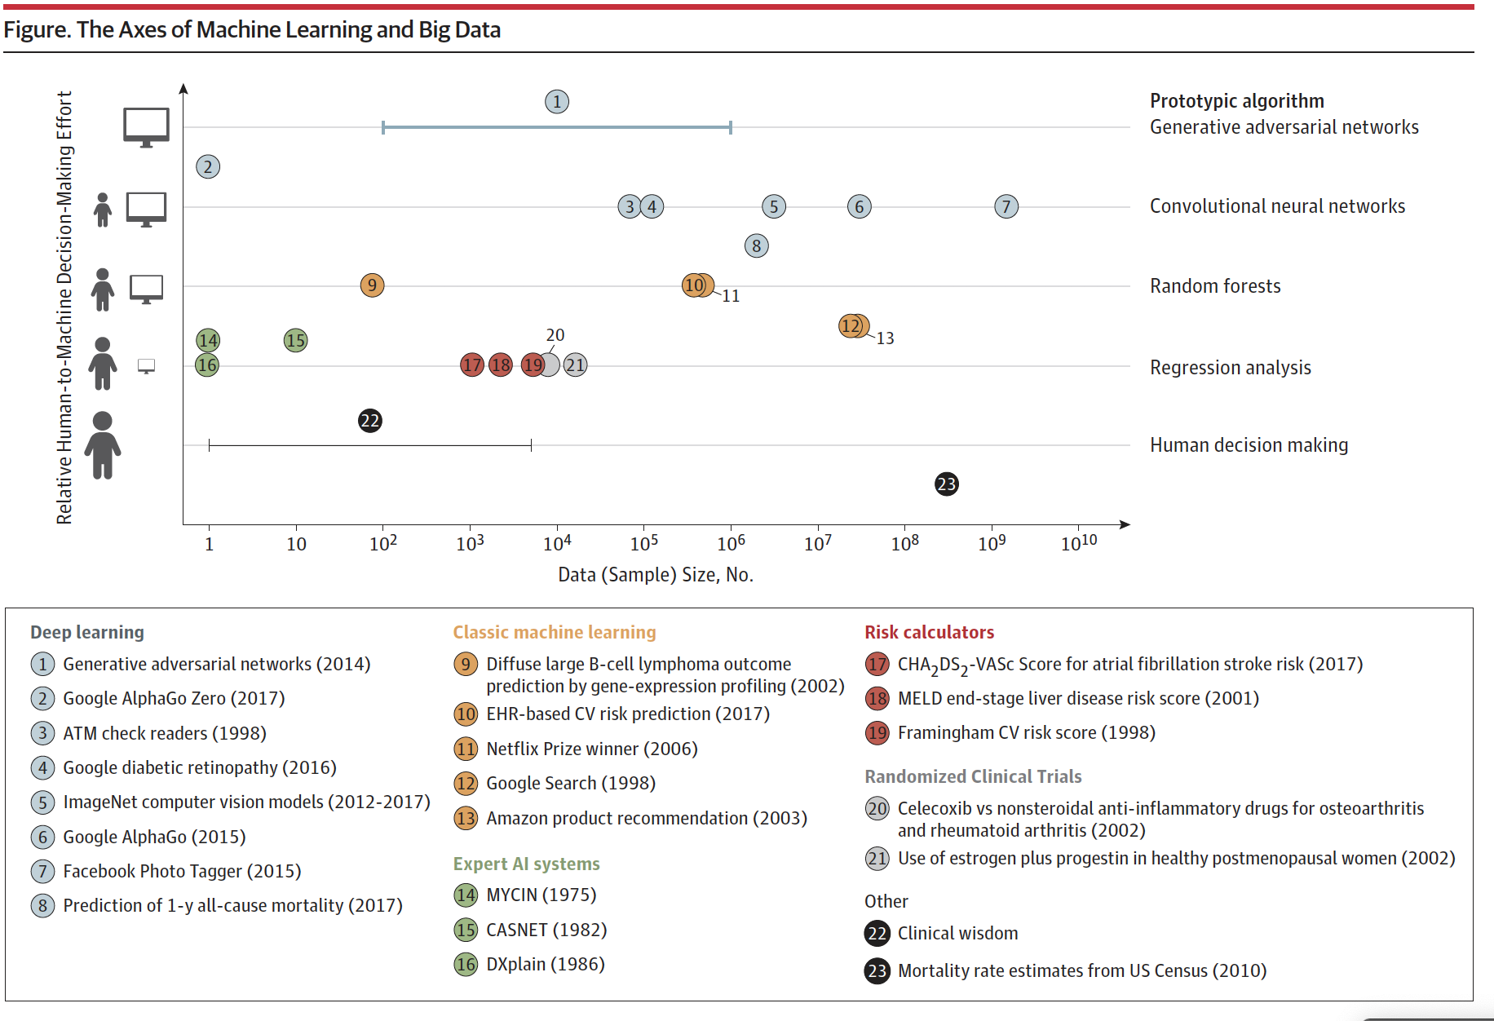
“Big Data and Machine Learning in Health Care” (2018)

Slide 39
A quick note on R vs Python
https://www.dataquest.io/blog/python-vs-r/

